Slide 1

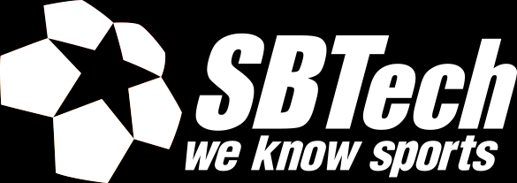
FRONT-END FOR LARGE SCALE APPLICATIONS
by Martin Chaov

Slide 2

Hi, I’m Martin!
Tech enthusiast
Software architect
Ex-designer
...at least for me...

Slide 3
Topics
LSAs
Widgets
Design for LSAs
Demo

Slide 4
What is a large scale application?
Performance
Scalability
Distributed architecture
Volume of data
Redundancy and availability
SOA
TDD, CD, CI
Team
Notes:
Let’s define what scale means:
What makes an application “large scale”? Many buttons and color variations aren’t really considered a merit for the definition of scale.
Performance
Being able to handle millions of users and transactions per second
Scalability
Vertical and Horizontal scalability in a distributed architecture (h -> more hardware; v -> upgrade existing). Database flexibility RDB, NoSQL, combination of products. Integration to make heterogenous solutions behave like a homogenous system.
Distributed architecture
Taking advantage of CDNs, cloud computing, on premises solutions
Volume of data
The amount of data being processed, analytics, reports, ORM, CRM
Redundancy and availability
Service oriented architecture
CD, CI
Team
People who actually keep alive this entire venture ☺ in multiple verticals such as: mobile, embedded, web, etc.

Slide 5
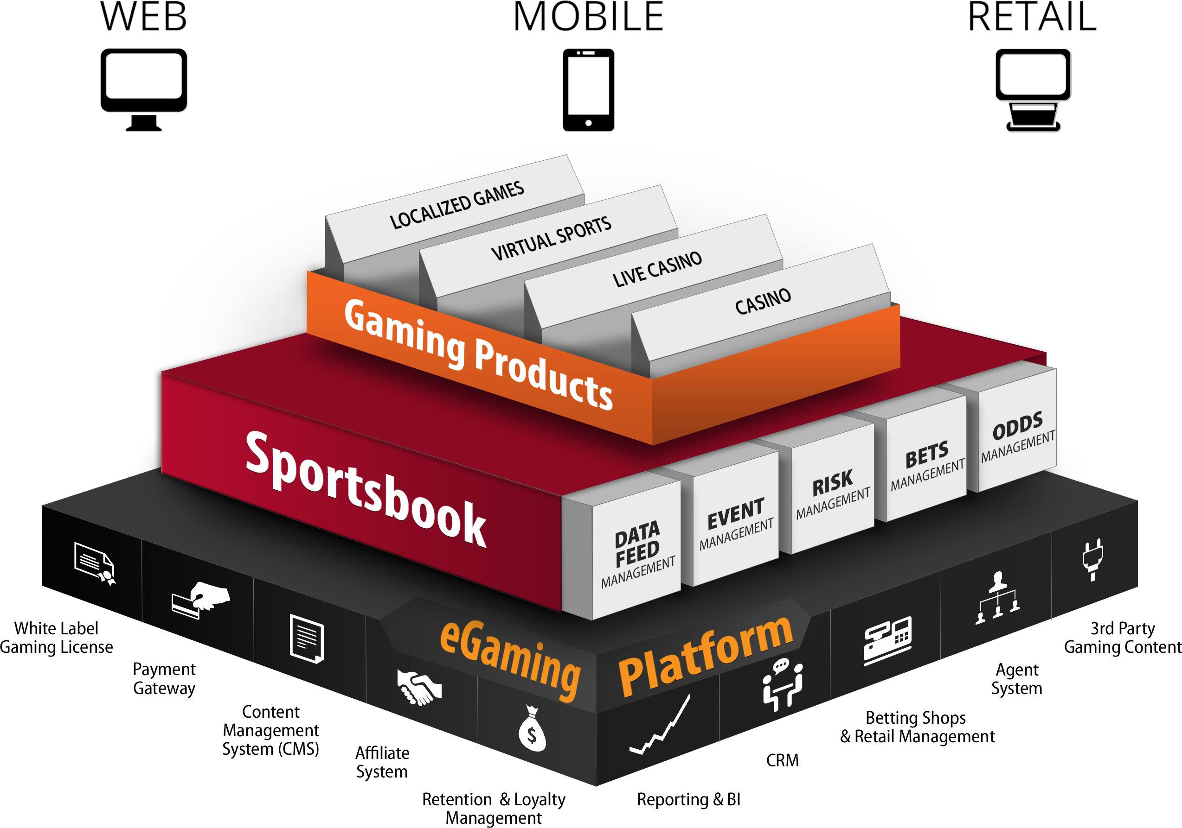
SBTech’s product line
60+ sports
2000+ betting markets
20 000+ live events per month
1500+ casino games
50+ payment methods
15+ regulated markets
20+ languages and currencies
150+ operators
RTL version in dev...
Notes:
Let me give you some context in terms of what we are dealing with in our company.
All of this is delivered across:
Web enabled devices
Native mobile applications
Retail terminals & custom hardware
Multi-lingual markets
Right-to-left version is in the making ☺

Slide 6
Notes:
Let me give you some context in terms of what we are dealing with in our company.
All of this is delivered across:
Web enabled devices
Native mobile applications
Retail terminals & custom hardware
Multi-lingual markets
Right-to-left version is in the making ☺

Slide 7
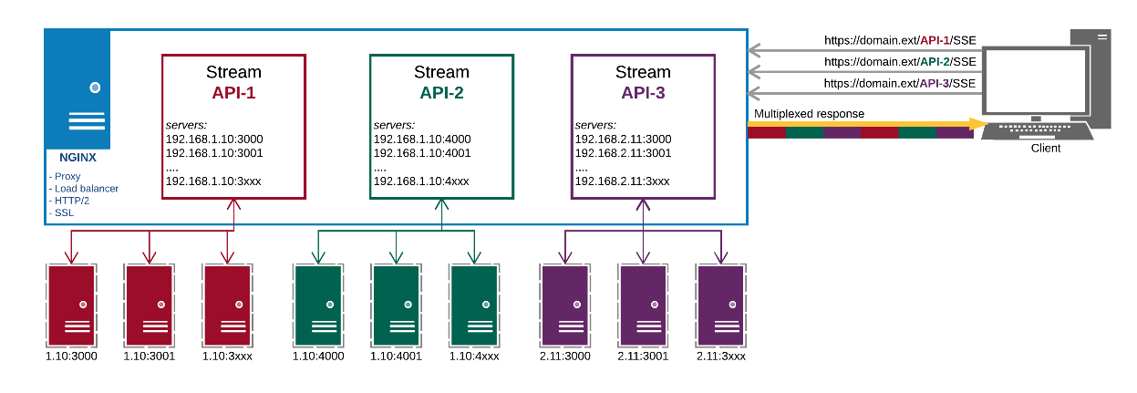
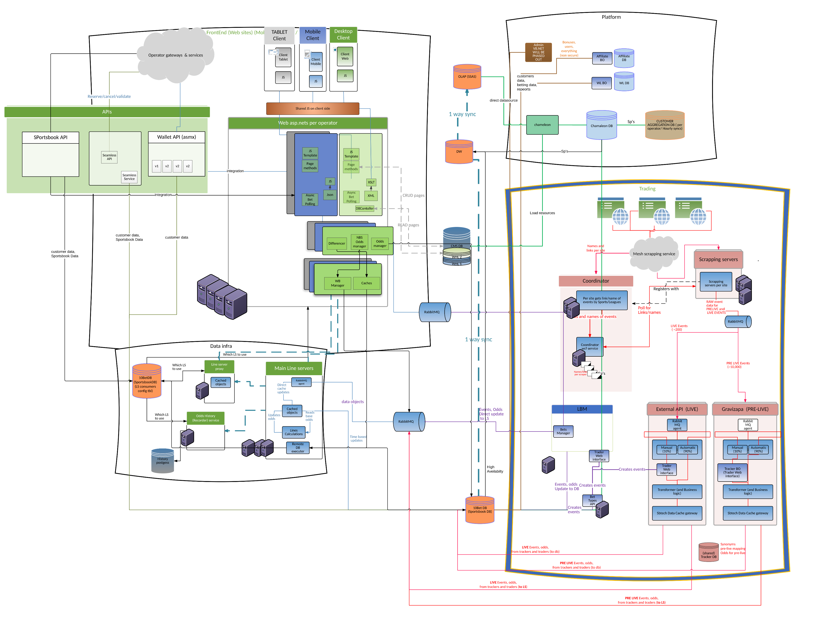
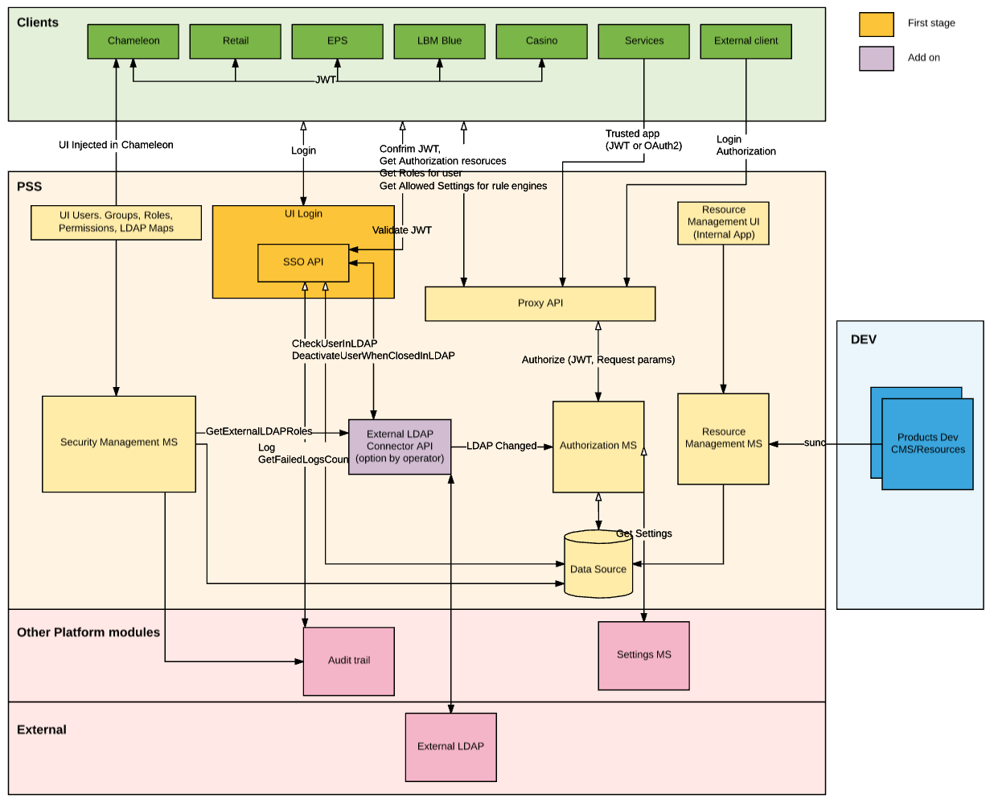
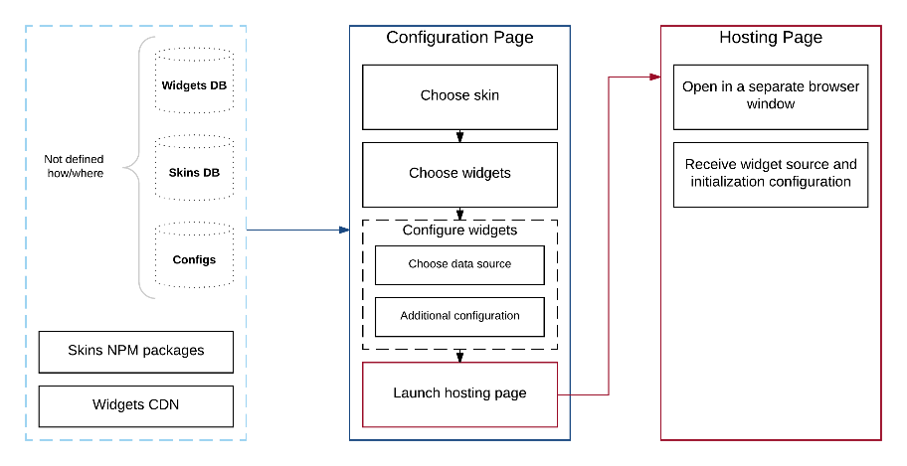
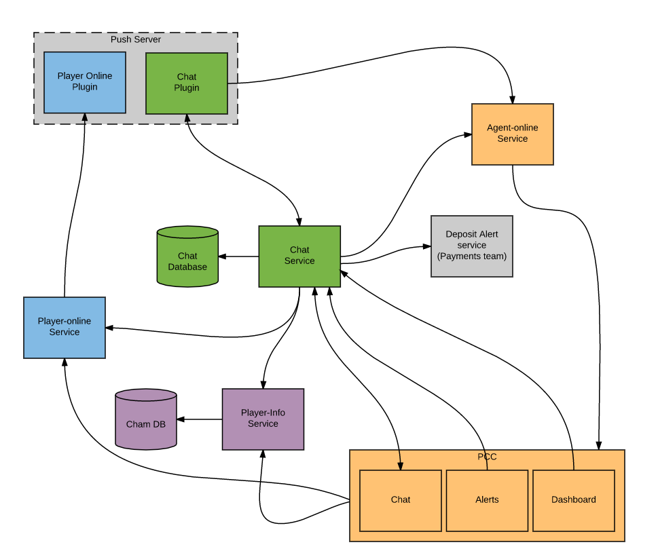
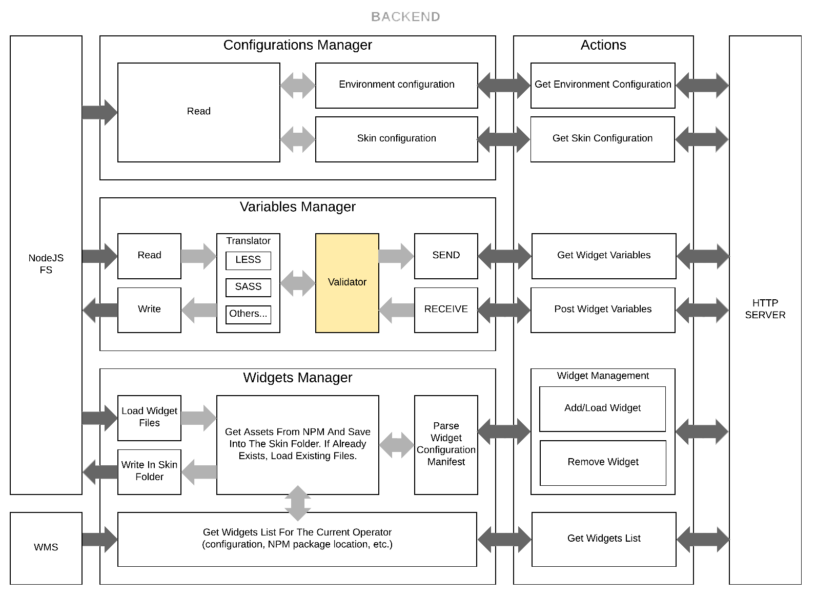
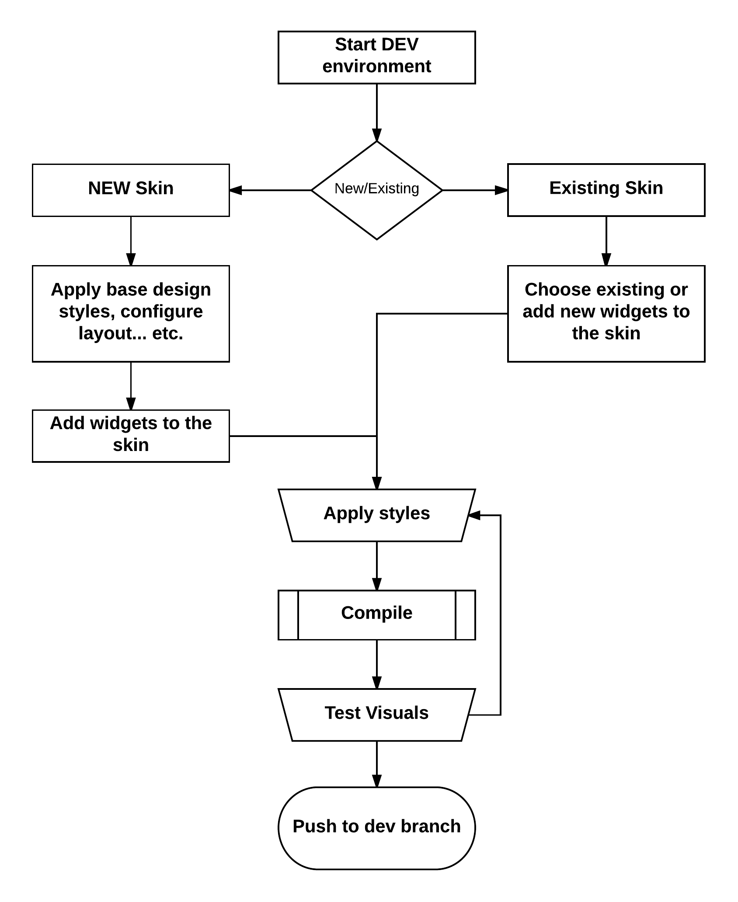
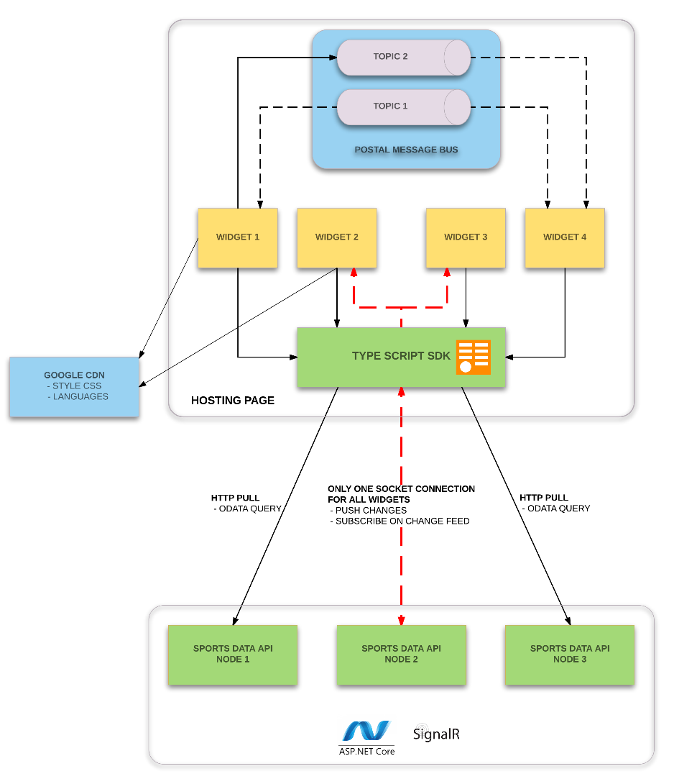
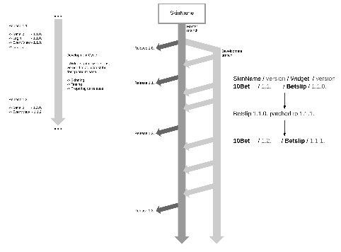
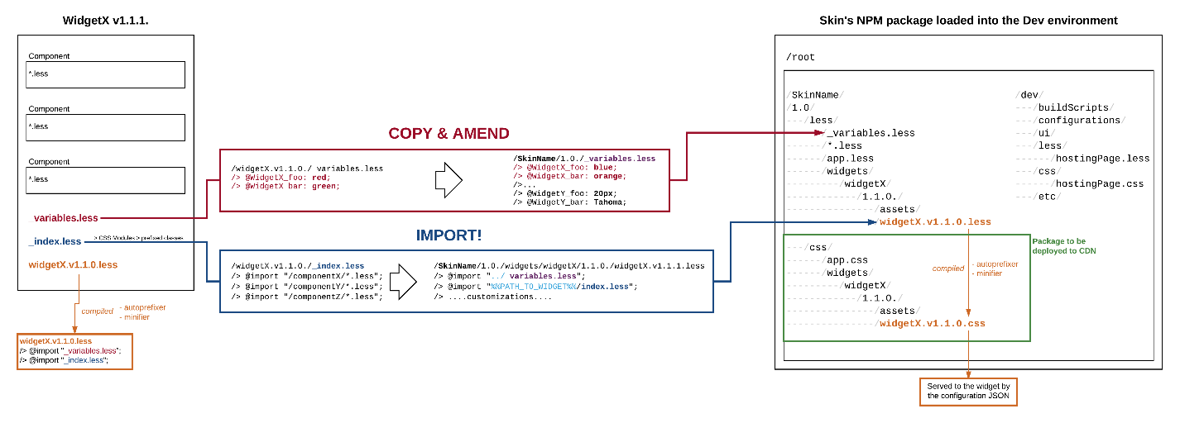

Slide 8
So, what about the front-end?
Scalable code base
Performance oriented
Responsive
Decoupled from the back-end
Notes:
To be able to answer this question we first need to define the requirements for the front end.
HLR:
Scalable
Performant
Responsive
Decoupled from the back-end

Slide 9
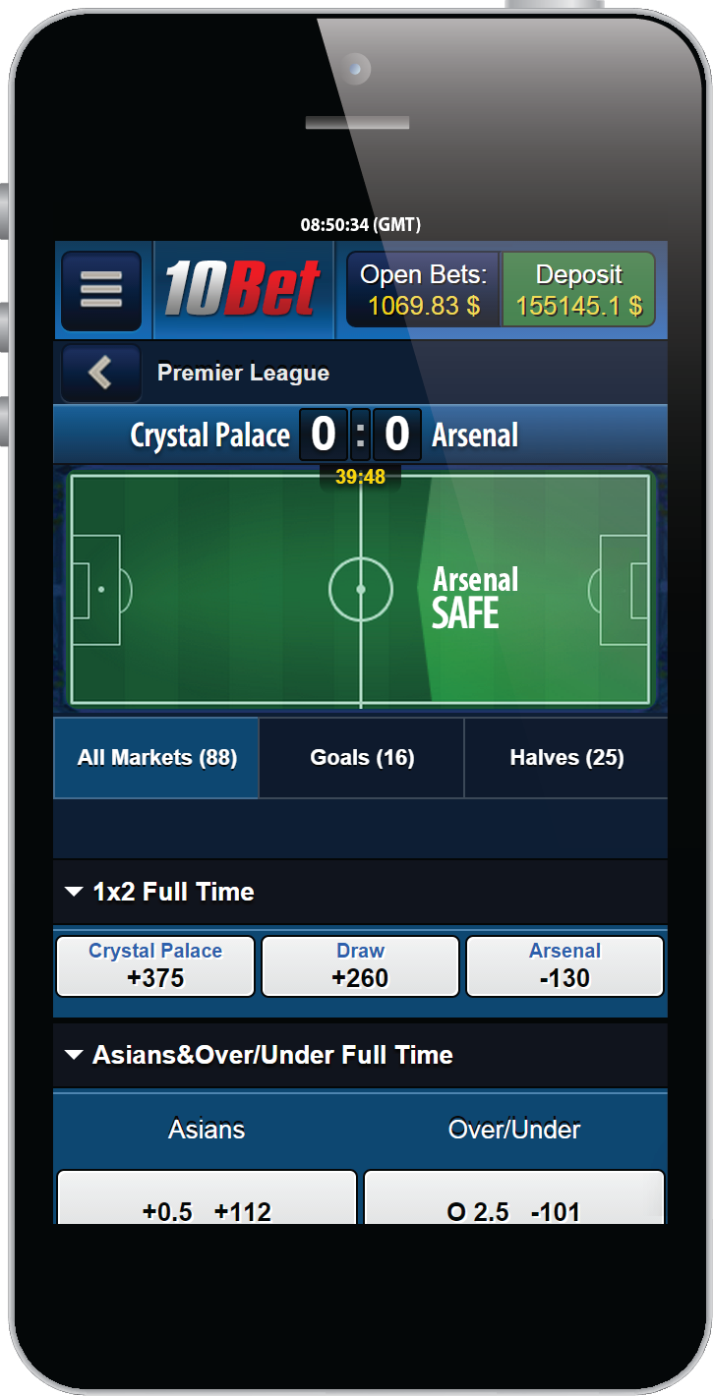
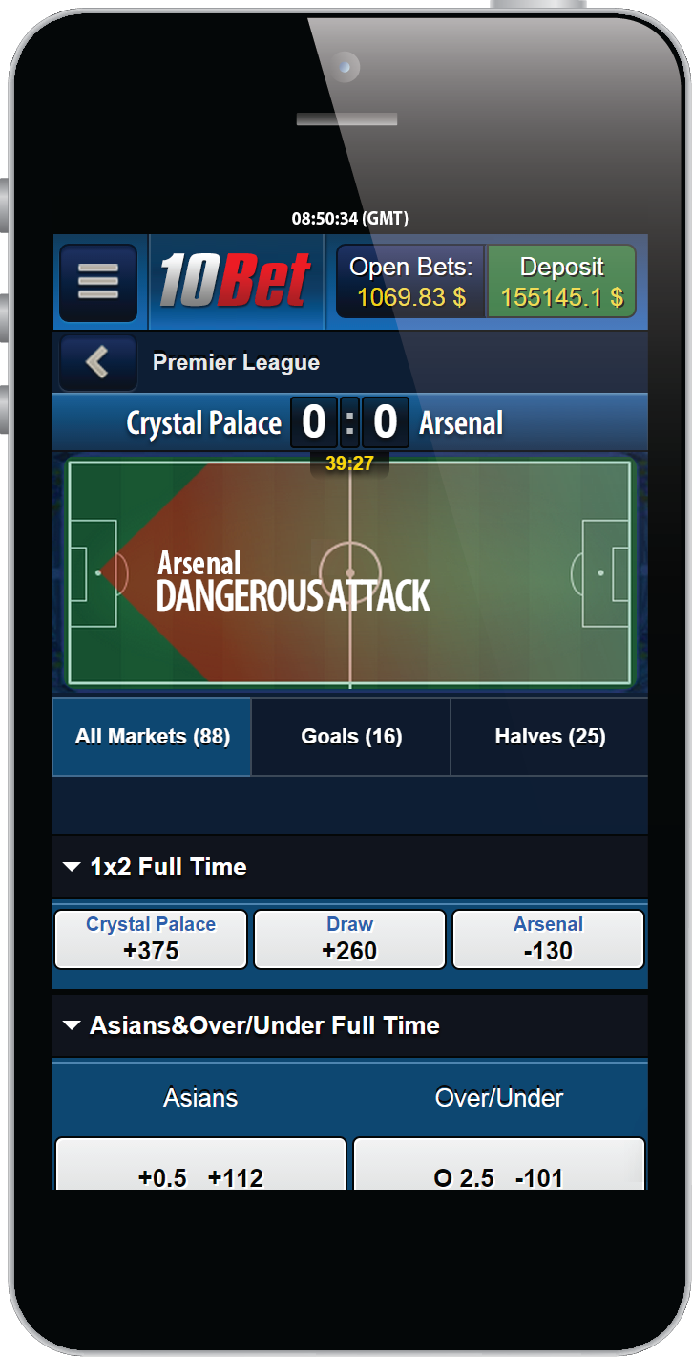
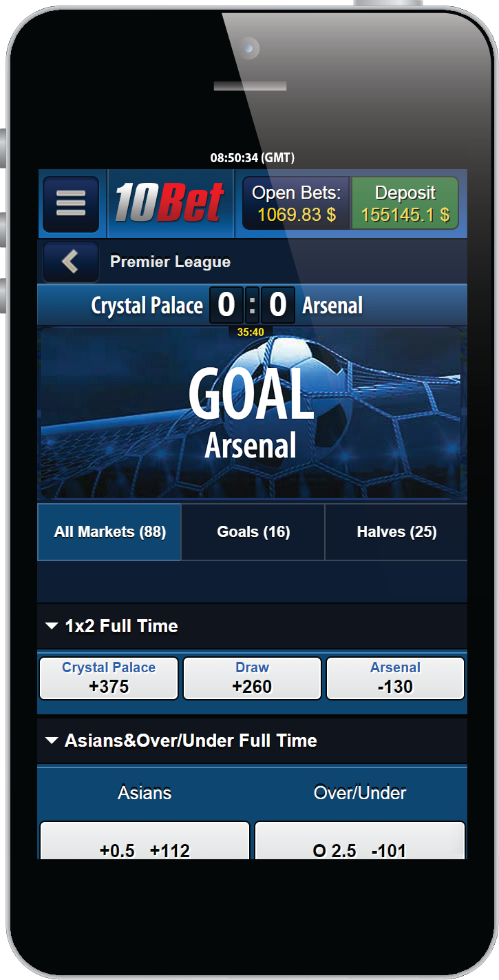
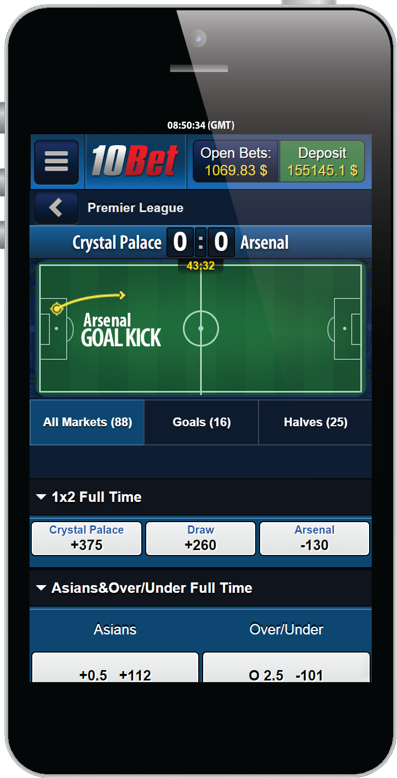
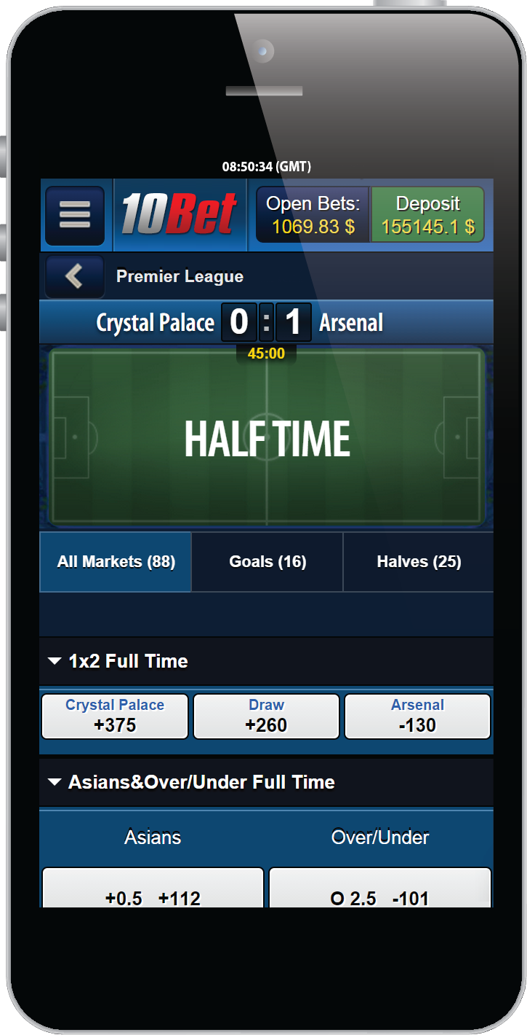
The widgets concept

Slide 10
What is a widget?
Stand alone and independent
Decoupled from other widgets
Decoupled from the back-end
Shares nothing!

Slide 11









Tech stack?
...and more...

Slide 12
How do you develop one?
TypeScript
React
Services
TDD

Slide 13
SBTech Platform
TypeScript
React
MobX
Etc.
Widgets project
Project
Dependencies
Widget
Component
Services
Component
Services
SBTech Scripts
Build
Test
Lint
Deploy
Component
Widget
Services
Component

Slide 14
Widgets project
Compiled Widget
Project
Dependencies
Widget
Component
Services
Component
Component
Component
Services
Widget
Component
Services
Services
Component
Project
Dependencies

Slide 15
HOSTING PAGE
WIDGET 1
WIDGET 2
WIDGET 3
WIDGET 4
CDN
API node
API node
API node

Slide 16
HOSTING PAGE
Message bus
WIDGET 1
WIDGET 2
WIDGET 3
WIDGET 4
CDN
API node
API node
API node

Slide 17
HOSTING PAGE
Message bus
Topic 1
Topic 2
WIDGET 1
WIDGET 2
WIDGET 3
WIDGET 4
CDN
API node
API node
API node

Slide 18
HOSTING PAGE
Message bus
Topic 1
Topic 2
WIDGET 1
WIDGET 2
WIDGET 3
WIDGET 4
TypeScript SDK
CDN
API node
API node
API node

Slide 19

WAIT

Slide 20
Something is missing

Slide 21
What about the design?

Slide 22
How do you scale the design?

Slide 23


Slide 24
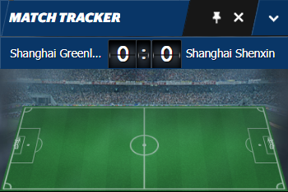
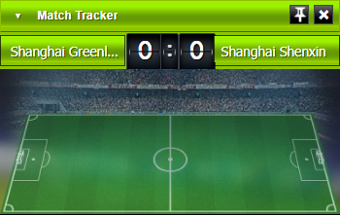
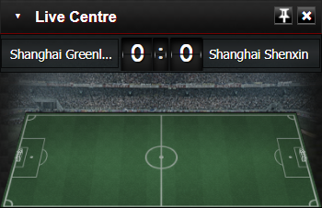
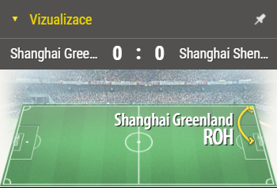
A step back
Widgets have design... duh
Design language is shared in an application

Slide 25
Design is compiled
Pre-processors
CSS Modules
BEM
Default colors palette

Slide 26
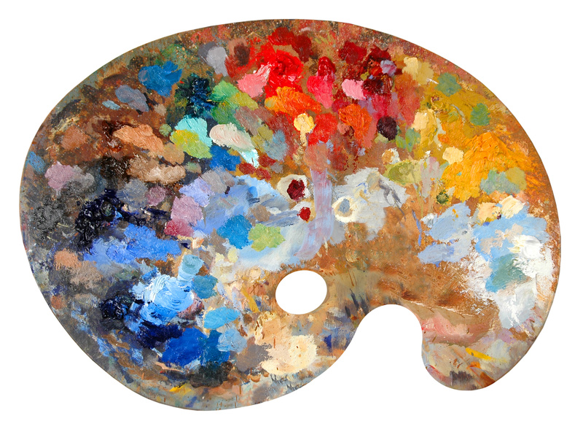
A palette?
x 150

Slide 27
Widgets project
Compiled Widget
Project
Dependencies
Widget
Component
Services
Component
DESIGN.LESS
Component
Component
Services
Widget
Component
Services
DEFAULT PALETTE
@primaryText: #000
@primaryBg: #FFF
@accent: #C70000
DESIGN.LESS
Services
Component
Project
Dependencies
DESIGN.LESS

Slide 28
Widgets project
DESIGN.LESS
Compiled Widget
Widget
Component
Services
DESIGN.LESS
Project
Dependencies
Component
Component
DESIGN.LESS
Component
Services
Widget
Component
Services
DEFAULT PALETTE
@primaryText: #000
@primaryBg: #FFF
@accent: #C70000
Services
Component
Project
Dependencies

Slide 29
Customized Design
Palette
Widget
Customized Design
Palette
Palette
Customized Design

Slide 30
SBTech.addWidget(
"sbtech-widget-event-view",
"fb9c4fb6-a6a6-4b85-86e5-1da0f0b96022",
{
"sbtech-widget-event-view": {
"props": { ... ... ... }
}
},
{
skinRootUrl: "http://URL.TO/desing.css"
}
);

Slide 31
WIDGET

Slide 32
Client X
Client Y
Client Z
WIDGET

Slide 33
Client X
Client Y
Client Z
WIDGET
CDN
CDN
CDN

Slide 34
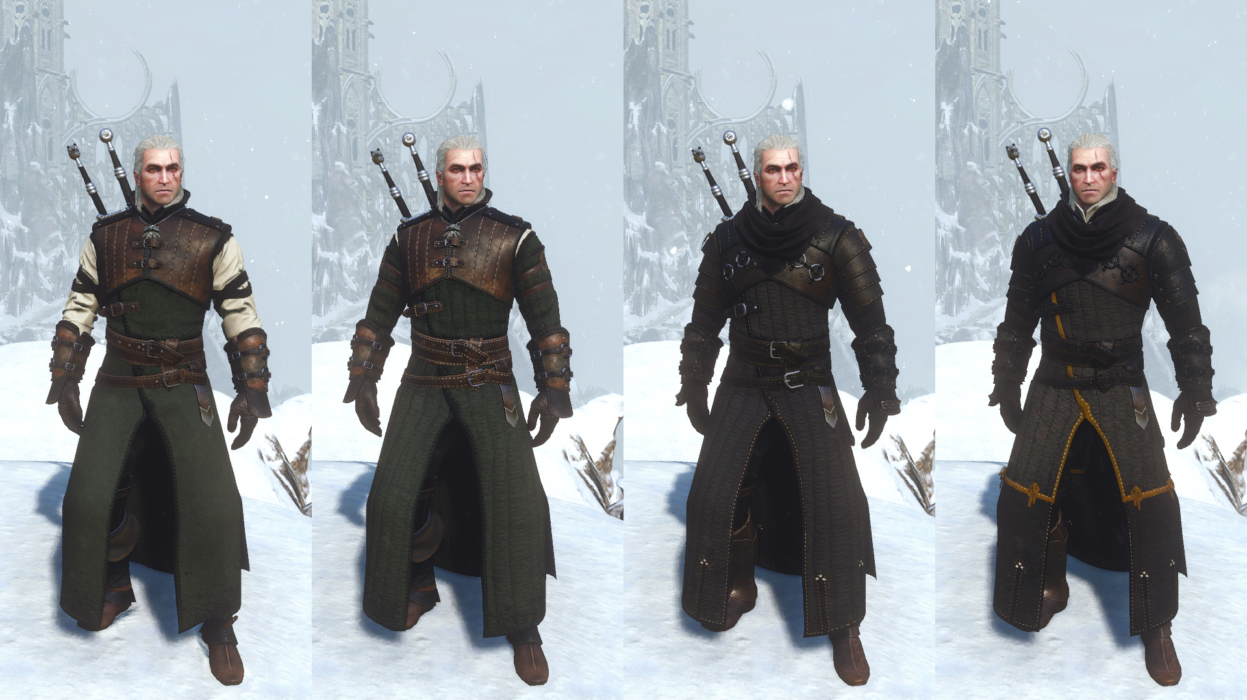
Geralt
APPROVES

Slide 35
But what if it’s more than just color changes?

Slide 36
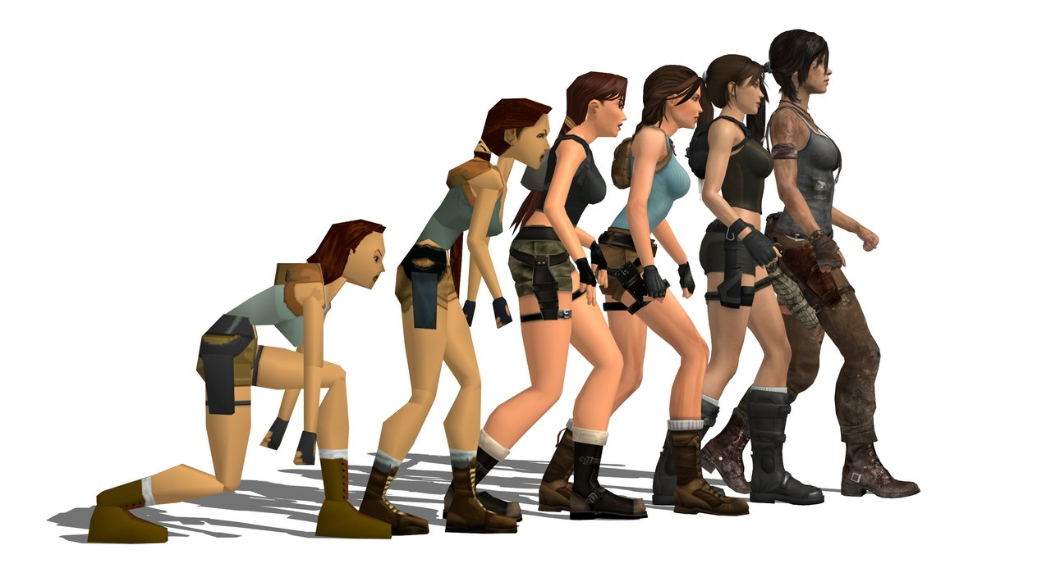
Version Evolution

Slide 37
|:}{:[ ~ What about a DEMO? ~ ]:}{:|

Slide 38


Slide 39


Slide 40

Connect ☺
LinkedIn: https://goo.gl/CRRJ2Y
Mail: martin.c@sbtech.com
Github: https://github.com/mchaov

